Slide 1
Deployment using Features and Solution Packages
developing reusable branding solutions
Notes:
This lecture takes what you have learned in earlier lectures and shows you how to package your custom branding files in a more reusable fashion using solution packages. More specifically, you will learn how to create custom branding solutions that are reusable, version-able and instantly deployable in any SharePoint 2010 environment. The lecture will demonstrate how to create SharePoint projects in Visual Studio 2010 that include features and template files to deploy custom master pages, CSS files and page layouts within the scope of a target site collection. You will also learn how to add custom C# code to a feature receiver and to program using the SharePoint server-side object model so can create features which automatically configure all the sites within a site collection to use one of your custom master pages upon feature activation.

Slide 2
Agenda
Understanding Solution Packages and Features
Developing with Visual Studio 2010
Creating a Custom Branding Solution
Creating Solutions to Deploy Page Layouts

Slide 3
SharePoint Solutions
SharePoint development based on solutions
Solution also referred to as "solution package"
Solution package is a CAB file with a *.wsp extension
Solution package is container of files distributed as unit
Solution package has manifest with install instructions
WingtipBranding.wsp
Mainifest.xml
Wingtip.master
WingtipMaster.css
Logo.gif
BackgroundBanner.jpg
WingtipBranding.dll
Notes:
When developing for SharePoint 2010, you’re required to package and deploy your development efforts using a SharePoint solution. At the physical level, a SharePoint solution is a set of files from a development effort that are compressed into a single CAB file known as a solution package.
The file name for a solution package must have an extension of .wsp. The strategy of packaging and distributing each SharePoint solution as a single self-contained file is important because it leads to an easier and less error-prone approach to deploying and updating a custom development effort in one or more SharePoint farms.

Slide 4
Solution Package Deployment
Solution packages can be deployed two ways…
as a farm solution
as a sandboxed solution
Farm solutions introduced in SharePoint 2007
They require deploying files and DLLs to Web server(s)
Deployment considered risky and requires farm admin
Sandboxed solution new in SharePoint 2010
Deployment pushes files into content DB
Deployment considered safe and can be done by users
Notes:
SharePoint 2007 allows you to deploy a solution package only at the farm level. SharePoint 2010 provides greater flexibility. You can deploy a solution package in SharePoint 2010 as a farm solution or as a sandboxed solution, which reduces the scope of deployment from the level of the farm to that of a single site collection. When you plan to develop a new SharePoint solution, you should consider whether you’ll ever want to deploy the resulting solution package as a sandboxed solution. If you do, you must learn how to create a SharePoint solution that can operate within the restrictions of the sandbox.
There is an important point about the new sandbox architecture that you should fully understand. Designing and developing SharePoint solutions that are compatible with the sandbox increases your options for deployment. This is because you can deploy a SharePoint solution that has been developed to target the sandbox as either a sandboxed solution or as a farm solution.

Slide 5
The SharePointRoot Directory
SharePoint Foundation relies on set of template files
Deployed to special directory known as SharePointRoot
SharePointRoot located on file system of Web server at this path
C:\Program Files\Common Files\Microsoft Shared\Web Server Extensions\14
Farm solutions deploy files into child folders in SharePointRoot
Path relative to SharePoint Root | Template file types
/Resources | Resource files (*.resx)
/TEMPLATE/ADMIN | Application pages used exclusively in Central Administration
/TEMPLATE/CONTROLTEMPLATES | ASP.NET User Controls (*.ascx)
/TEMPLATE/FEATURES | Feature definition files (*.xml)
/TEMPLATE/IMAGES | Images (*.gif, *.jpg and *.png)
/TEMPLATE/LAYOUTS | Application pages (*.aspx)
/TEMPLATE/LAYOUTS/1033/STYLES | CSS Files (*.css)
/TEMPLATE/LAYOUTS/ClientBin | Silverlight components (*.xap)
/TEMPLATE/SiteTemplates | Site Definition files (onet.xml)
/TEMPLATE/XML | Custom field type definition files (fdltype*.xml)
Notes:
The fundamental architecture of SharePoint Foundation relies on a set of template files that are stored in a special directory on the local file system of each front-end Web server. In SharePoint 2007, this directory went by several different names, including the SharePoint System directory and the 12 Hive. In SharePoint 2010, the SharePoint product team has formalized the name of this directory to be the SharePoint root directory. A typical installation of SharePoint Foundation or SharePoint Server 2010 creates the SharePoint root directory at the following path.
C:\Program Files\Common Files\Microsoft Shared\Web Server Extensions\14
If you’ve installed only SharePoint Foundation and not SharePoint Server 2010, the SharePoint root directory contains a stock set of images, templates, features, and pages. If you install SharePoint Server 2010, the SharePoint root directory contains the same stock files of SharePoint Foundation and also a wealth of template files to provide additional functionality beyond that supplied by SharePoint Foundation.
When creating a SharePoint solution it is possible to add template files that requires deployment inside the SharePoint root directory. The table in the slide above lists some of the more commonly used directories along with the types of template files they contain. However, note that the requirement to deploy files in the SharePoint root directory limits you to farm solution deployment. If you want to leave the option open to deploy a SharePoint solution as a sandboxed solution, you must avoid deployment dependencies on the SharePoint root directory.

Slide 6
Creating Sandbox-Friendly Solutions
Avoid Deployment in SharePointRoot directory
Avoid application pages or user controls
Avoid deploying anything to /LAYOUTS or /IMAGES
Deploy files into the virtual file system of sites
Deploy master pages to Master Page Gallery
Deploy page layouts to Master Page Gallery
Deploy CSS files and images to Style Library
Deploy files as root folder of site or in created folders
Notes:
Many SharePoint developer techniques cannot be used when you are developing sandboxed solutions. For example, a sandboxed solution cannot deploy files within the SharePoint root directory or any other location on the file system of the web server. That means you cannot deploy branding files to familiar locations that are commonly used in farm solutions, such as the IMAGES directory or the LAYOUTS directory.
The choice for deploying master pages and page layouts is easy because they must be deployed in the Master Page Gallery of a site. In most scenarios is makes sense to deploy master pages and page layouts once per site collection in the Master Page Gallery of the top level site.
When it comes to deploying CSS files and images, you should generally prefer to deploy these types of files in the Style Library. This is an ideal deployment location for CSS files and images because it is guaranteed to exist once per site collection in the top-level site.
When you write code for a sandboxed solution, there are other noteworthy limitations when you access server-side object model. Fortunately, this does not have a limiting effect on custom Branding solutions because you can still access the parts of the server-side object model which are required to update properties of a site object (SPWeb) such the MasterUrl property and AlternateCssUrl property.

Slide 7
Designing and Implementing Features
What is a SharePoint Feature?
mechanism for adding elements to target site
A unit of design and implementation
A building block for creating SharePoint solutions
Features can add elements to target site
e.g. menu items, list instances, list types and modules
Many other element types possible
Features can have Feature Receivers
Acts as event handler for events like feature activation
Allows for custom code which programs object model
Notes:
Although you can create many different types of templates and components within a SharePoint solution, you really should start by learning about creating features. A feature provides a mechanism for adding elements to a target site or site collection through a process known as feature activation. The types of elements that can be added to a site for branding include master pages, page layouts, CSS files, images and site page templates.
The high-level design of a SharePoint solution typically starts with adding one or more Features. When you add a Feature to a sandboxed solution, you can assign the Feature with an activation scope at either the site level or the site collection level. However, a sandboxed solution cannot contain a Feature that has an activation scope at the farm level or the web application level.

Slide 8
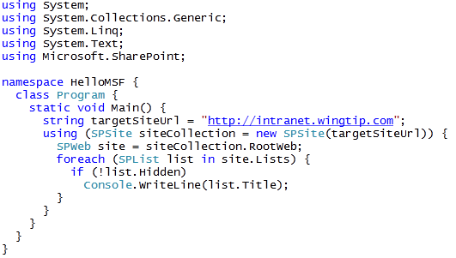
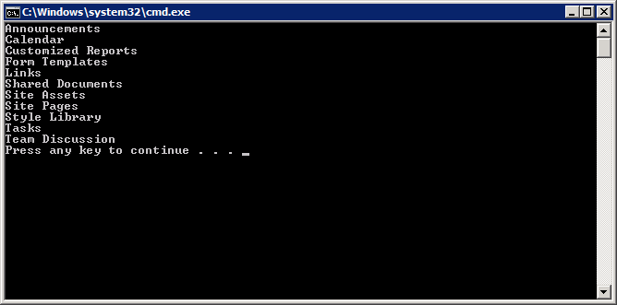
Server-side Object Model
Notes:
The core server-side object model of SharePoint Foundation is served up through an assembly named Microsoft.SharePoint.dll. Once you reference this assembly within a Visual Studio 2010 project, you can start programming against the classes in the server-side object model, such as SPSite, SPWeb, and SPList.
There are two initial requirements for a Visual Studio project that programs against the server-side object model using the Microsoft.SharePoint assembly. First, the project must be configured to use .NET Framework 3.5 as its target framework. The second requirement is that your project must have a platform target setting that is compatible with a 64-bit environment, which is essential for properly loading the Microsoft. SharePoint assembly.
Another critical requirement for any application or component that is programmed against the server-side object model is that the application or component must be deployed and run on a front-end Web server or application server in a SharePoint farm. This issue doesn’t usually come up when you’re creating standard SharePoint components such as Feature Receivers, event receivers and Web Parts because these component types are deployed using SharePoint solutions, which make it possible to install and execute them on all front-end Web servers in a SharePoint farm. However, if you are creating a Console application project to write and test code using the server-side object model, you must run and debug your project on a front end Web server.

Slide 9
DEMO
Using the SharePoint Object Model
from a Console Application

Slide 10
Agenda
Understanding Solution Packages and Features
Developing with Visual Studio 2010
Creating a Custom Branding Solution
Creating Solutions to Deploy Page Layouts

Slide 11
SharePoint Projects in Visual Studio 2010
SharePoint Projects used for SharePoint Solutions
Made possible by SharePoint Developer Tools in VS 2010
SharePoint Projects created using special project templates
SharePoint Projects provide special project item templates
Output of SharePoint Project is a Solution Package
SharePoint Project make testing easy
Requirements for developing SharePoint Projects
Development done on SharePoint farm built as single server
All development done for SharePoint 2010 or later
Notes:
The SharePoint development tools in Microsoft Visual Studio 2010 provide a simple and effective approach to developing solution packages giving you an effective means to package and deploy the files and code that are required to apply branding to SharePoint 2010 sites. This makes it relatively simple to create sandbox-compatible branding solutions which deploy custom master pages, CSS files and images that can be deployed to SharePoint 2010 farms that are running either SharePoint Foundation 2010 or SharePoint Server 2010.

Slide 12
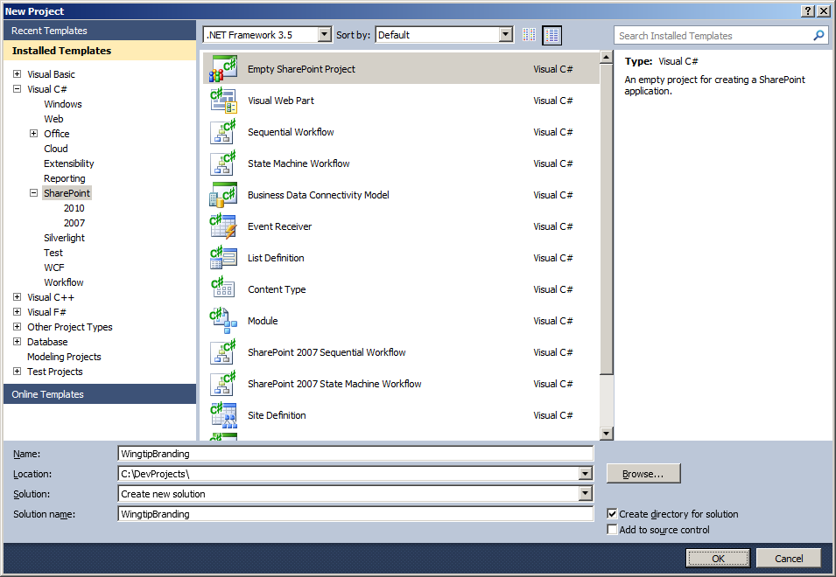
SharePoint 2010 Project Templates
SharePoint Tools provide several project templates
All project templates generate "SharePoint project"
SharePoint projects have extended set of properties and behaviors
Notes:
The SharePoint development tools provide several project templates depending of which type of SharePoint artifact you want to develop. There are project templates for web parts, application pages, list definitions, content types, workflows, etc. However, in most cases you can simply create a new project using the Empty SharePoint Solution project template. Once you have created the new project, you can simply add features and other types of items using project item templates also provided by the SharePoint development tools .

Slide 13
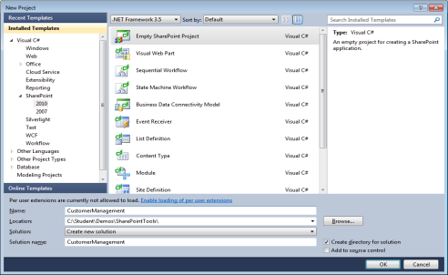

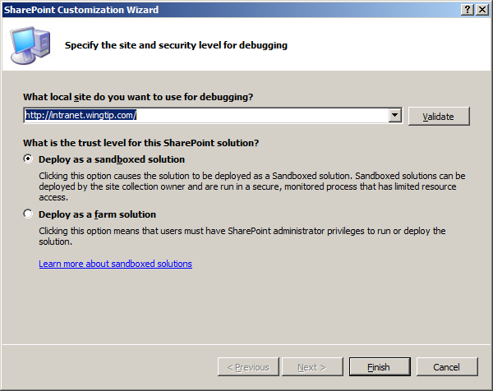
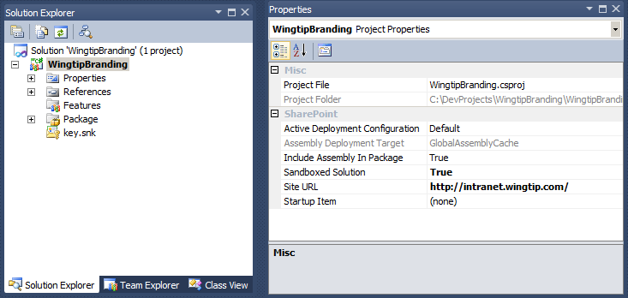
SharePoint 2010 Project Properties
SharePoint Projects properties
Project File
Project Folder
Active Deployment Configuration
Include Assembly in Package
Assembly Deployment Target
Sandboxed Solution
Site URL
Startup Item
Notes:
When you create a SharePoint project based on one of the SharePoint project templates, you are guided through a wizard where you have to enter a valid SharePoint URL and set some other properties based on the selected project template. These values are reflected in the project Properties window.

Slide 14
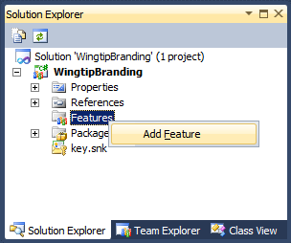
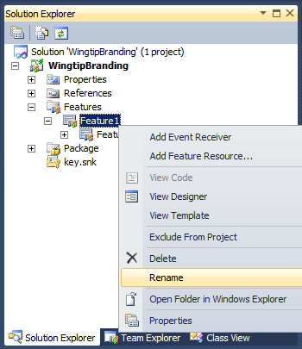
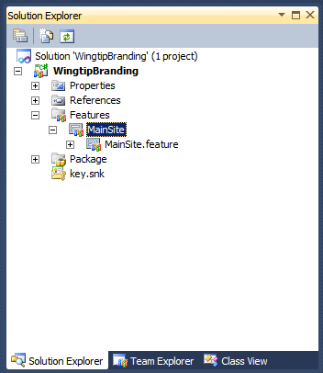
Adding a New Feature
Right-click Features node and select Add Feature
Right-click new feature node and select Rename
Notes:
You can add additional features to a SharePoint project by right-clicking the Features node and selecting Add Feature. New features have names like Feature1 and Feature2. When a feature has been created, you should rename it right away.
Every SharePoint feature requires a special file named feature.xml. However, you rarely have to deal directly with a feature.xml file. That's because the SharePoint developer tools create and update the feature.xml behind the scenes and seemlessly build it into the output solution package of the current project.

Slide 15
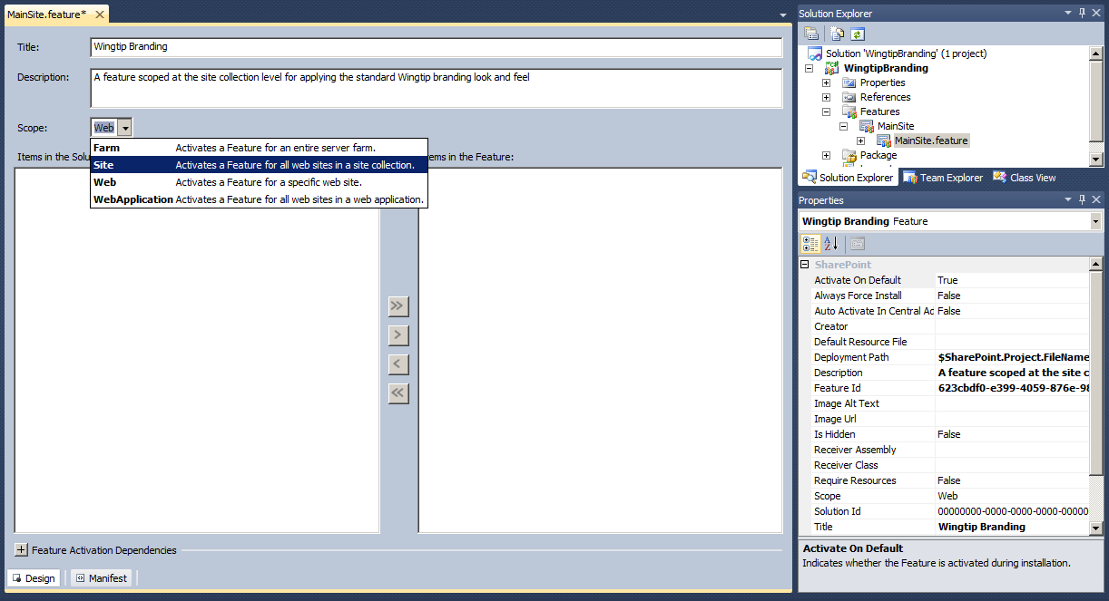
Feature Designer and Property Sheet
Each Feature has designer and property sheet
Feature designer provides design mode and XML text mode
Customize feature properties in designer and / or property grid
Notes:
The SharePoint development tools provide a Feature Designer where you can change some properties like the title of the feature and its scope.
Each feature also has a property sheet where you can also modify properties.
If you need to make additional changes to the feature definition, you can edit the feature manifest by clicking the [+] button next to Edit Options and type in your changes.

Slide 16
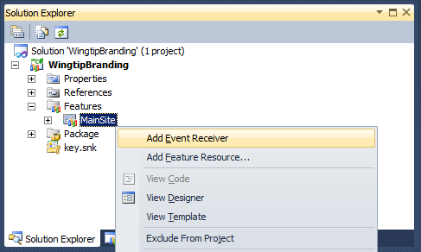
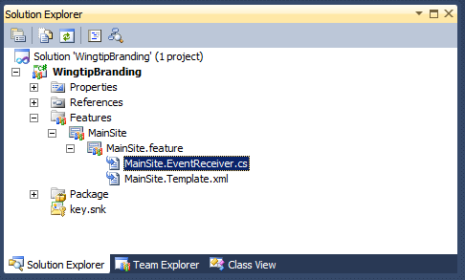
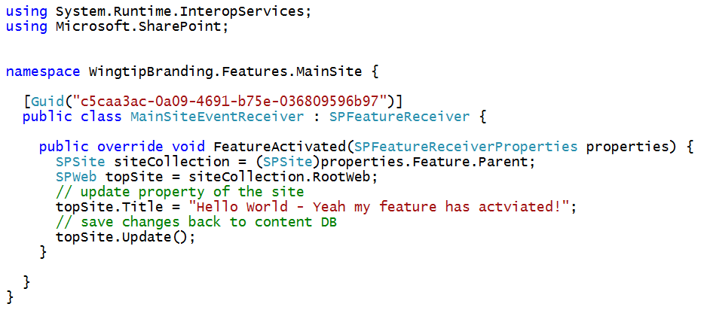
Creating a Feature Receiver
Notes:
A feature can be extended with a Feature Receiver. A Feature Receiver allows you to write event handlers in a managed programming language such as C# or Visual Basic. These event handlers are executed during feature-specific events such as feature activation and feature deactivation. The code you write in these event handlers can access the SharePoint Foundation server-side object model, making it possible to modify the target site. For example, you can write an event handler that fires during feature activation and performs routine initialization tasks such as updating site properties so each site in a site collection links to a single master page in the Master Page Gallery of the top level site.

Slide 17
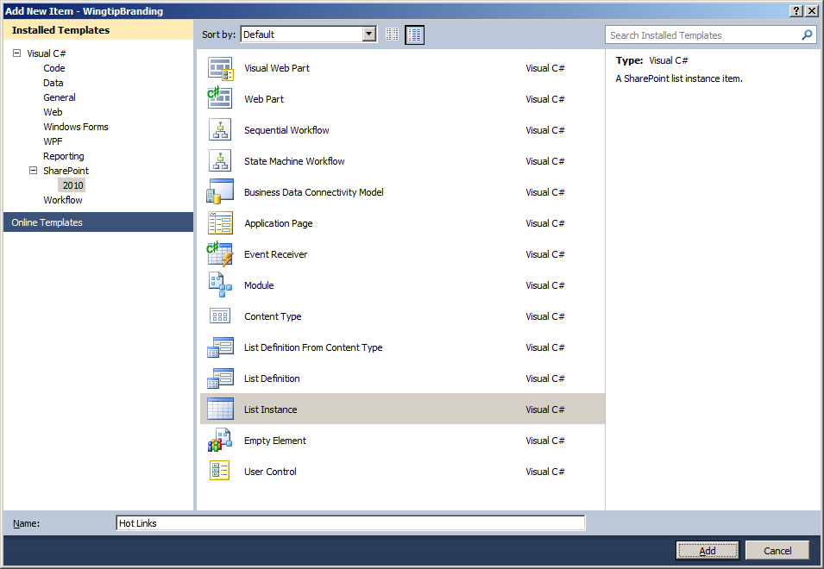
Creating Project Items
SharePoint projects provide item templates
Used to add items like lists, modules and Web Parts
Notes:
The primary way you extend the functionality in a SharePoint project is by adding new items created from special project item templates provided by the SharePoint Developer Tools. These items are known as SharePoint project items. You can see these templates inside the Add New Item dialog as shown in the slide above.

Slide 18
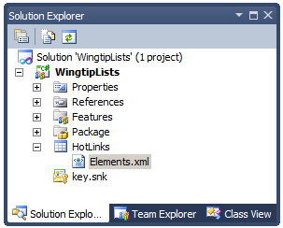
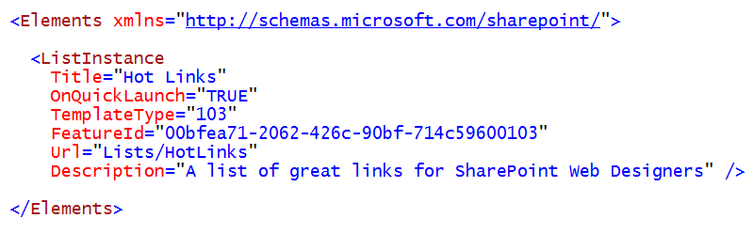
Element Manifest Files
Project items have element manifest files
Named elements.xml by SharePoint developer tools
In some cases the tools make all required updates
In other cases, you must edit elements.xml file by hand
Notes:
The element manifest files in Features is the way you will declarative do work when a Feature is activated.

Slide 19
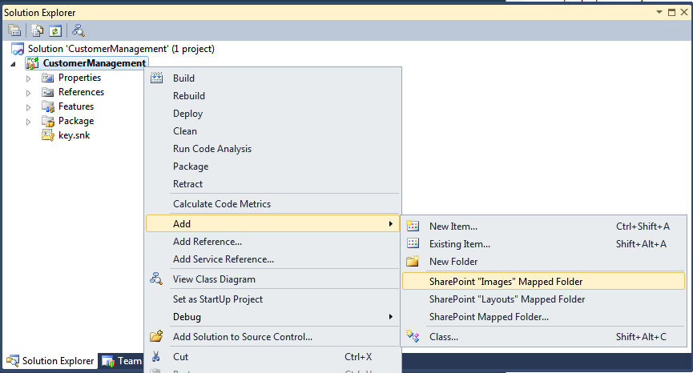
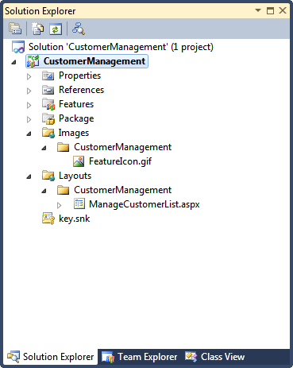
Mapped Folders
Mapped Folders used to deploy to SharePoint Root
Layouts mapped folder deploys to /_layouts virtual directory Layouts folder used to deploy application pages, CSS files, .js files, etc
Images mapped folder deploys to /_layouts/images Images folder used to deploy graphics files (eg .gif, .jpg, .png, etc)
Caveat: not allowed in sandboxed solutions
Notes:
Some SharePoint items require you to deploy files to the SharePoint Root Directory. For example, application pages must be deployed inside the _layouts folder. Images can be deployed in the _layouts/images folder. In Visual Studio 2010 you deploy files in the SharePoint Root directory by adding mapped folders to a SharePoint project.
In order to create a mapped folder, right-click the project in the Solution Explorer, choose Add » SharePoint “Layouts” Mapped Folder or SharePoint “Images” Mapped Folder. If you need to deploy files to another folder in the SharePoint root, you can choose Add » SharePoint Mapped Folder. A dialog will open where you can select the desired folder from a treeview representing the SharePoint folder tree.
Remember that sandboxed solutions cannot deploy any files into the SharePoint root directory. Therefore, you should avoid using mapped folders inside any SharePoint project that you want to be able to deploy as a sandboxed solution. Fortunately, there are sandbox-friendly alternatives to using mapped folders when create a custom branding solution.

Slide 20
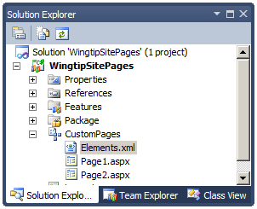
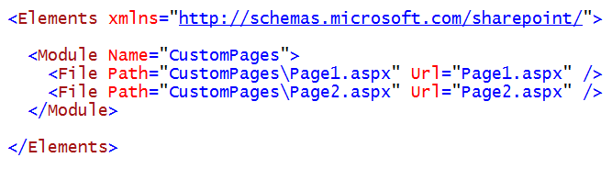
Modules
Modules are used to deploy files to a site
Files created in site from underlying template files
Module element contains inner File elements
File element Path attribute points to template file
File element Url attribute has name of file to create
Notes:
When you add a new Module SharePoint Project Item Type into a SharePoint project, the SharePoint Developer Tools create a new top-level folder in the project, which initially contains two files named elements.xml and sample.txt. The elements.xml file is important because it contains the Module element CAML markup that will be used to create files within the target site from file templates. The sample.txt doesn’t really have any purpose so can delete or rename it.
At a high level, you can think of a Module element as a file set. When you create a Module, you add one or more inner File elements. The key point is that each File element is used to create an instance of a file from a file template. The example shown in the slide above is creating two site pages from a pair of site page templates. Keep in mind that the site page templates exists on the file system of the Web server inside the directory of the hosting feature when the hosting solution package is deployed as a farm solution. When the solution package is deployed as a sandboxed solution, the site page templates exists in the solution package's CAB file inside the content database. However, the site page instances are created by adding entries to the content database.
Note that the File elements in this example are created with Path attribute values that references the site page templates named Page1.aspx and Page2.aspx. The Url attribute contains the name of the site pages being created, which in this case uses the same names as used for the site page templates. When you activate the feature that contains this Module element, SharePoint Foundation creates two site page instances within the root folder of the target site.

Slide 21
DEMO
Creating Sites Pages using a Module
and a Site Page template

Slide 22
Agenda
Understanding Solution Packages and Features
Developing with Visual Studio 2010
Creating a Custom Branding Solution
Creating Solutions to Deploy Page Layouts

Slide 23
Creating a Custom Branding Solution
Files for Branding Solution requiring deployment
Master Pages to Master Page Gallery
CSS files and images to Style Library
Code is required in typical Branding Solution
Updates required to MasterUrl property of each site
Some scenarios required updates to CustomMasterUrl
Some scenarios required updates to AlternateCssUrl
Notes:
The SharePoint development tools in Microsoft Visual Studio 2010 provide a simple and effective approach to packaging and deploying the files and code that are required to apply branding to SharePoint 2010 sites using a sandboxed solution.
This section will walk through a best practice for creating a sandbox-compatible branding solution which uses a custom master page, a custom CSS file and images that can be deployed to SharePoint 2010 farms that are running either SharePoint Foundation 2010 or SharePoint Server 2010. Furthermore, the technique shown here can be deployed as either a farm solution or a sandboxed solution.

Slide 24
Add a Feature with Site Collection Scope
Branding solution requires a main feature
Set Scope to Site to activate at site collection level
Give the feature a meaningful name such as MainSite
Notes:
When you begin developing sandboxed solutions, it is important to distinguish between Features that activate at site collection scope and Features that activate at site scope. This is because a Feature that is configured to activate at site collection scope is automatically activated when the user activates the sandboxed solution that contains it. On the other hand, Features that are configured to activate at site scope are not automatically activated. They must be manually activated by the user or activated by using custom code.
For this reason, you should generally design a sandboxed solution with at least one Feature configured to activate at site collection scope. This enables you to take control when the user activates your sandboxed solution. In our example, this feature has been named MainSite to signify it has a scope value of Site and, therefore, activates at site collection level.

Slide 25
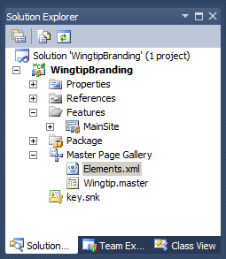
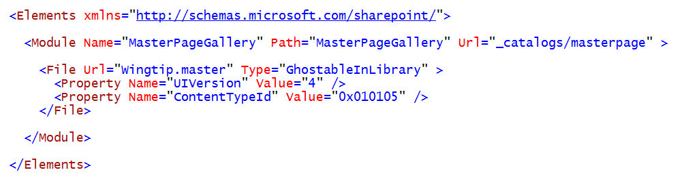
Add a Module to Deploy Master Pages
Create Module to deploy to Master Page Gallery
Add master page file(s) to Module folder
Make edits by hand to Module element in element.xml
Notes:
When you create a Module element to provision files in a document library, such as the master page gallery, it is important that you configure the Url attribute of the Module element by using the site-relative path to the root of the document library. This is something you must do by hand when using the SharePoint developer tools.
When you provision a master page to the master page gallery, the Url attribute of the Module element should always be configured with the standard path of _catalogs/masterpage. When you provision a file into the scope of a document library, each File element should contain a Type attribute with a value of GhostableInLibrary, as seen in the slide above. When you provision master pages in SharePoint 2010, you should also add two Property elements inside the File element to configure two important properties named UIVersion and ContentTypeId.
SharePoint Foundation uses the UIVersion property of a master page to differentiate between master pages designed for the new SharePoint 2010 UI and the older SharePoint 2007 UI. If you design your master page based on the SharePoint 2010 UI, you should configure the UIVersion property with a value of 4.
The ContentTypeId property is used to differentiate between master pages and page layouts that are used in publishing sites. When you deploy a master page, you should configure it with the correct ContentTypeId value for master pages, which is 0x010105.

Slide 26
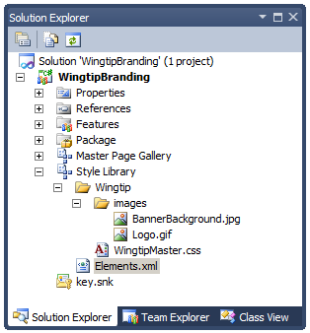
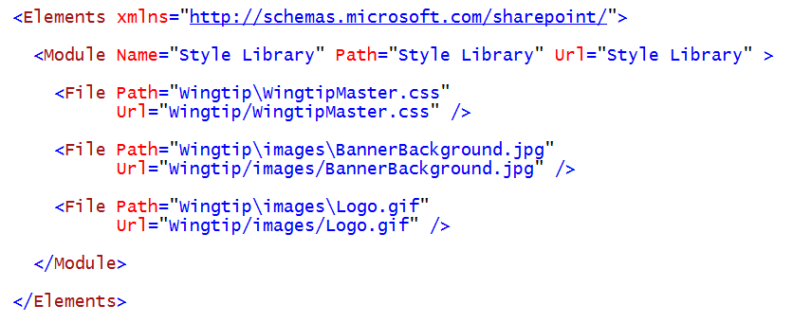
Add a Module for Style Library Deployment
Create Module to deploy to Style Library
Add CSS file(s) to child folder (e.g. Wingtip)
Add images to their own folder (e.g. Wingtip/images)
Notes:
It is a best practice in SharePoint 2010 to deploy custom CSS files in the Style Library because it works with both sandboxed solutions and farm solutions. This technique works in farms that are running SharePoint Server 2010 and also farms that are running only SharePoint Foundation. It must be noted that many other common approaches to branding SharePoint 2010 sites do not provide this level of flexibility. For example, a custom solution which deploys CSS files to the IMAGES folder inside the SharePoint Root directory is limited to farm deployment and cannot be deployed as a sandboxed solutions.

Slide 27
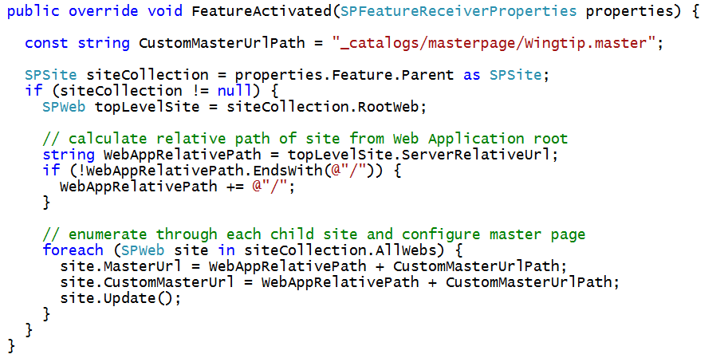
Add a Feature Receiver
Feature Receiver used to configure master pages
Modify MasterUrl property of each site in site collection
Modify CustomMasterUrl property for publishing sites
Master Page URL must be relative to Web application
Notes:
A Branding Solution should typically contain a main feature that activates at the level of the site collection. When the feature is activated, it should have a receiver that executes code to redirect all the sites in the current site collection to use a special master page.
The code shown in the slide above obtains a SPSite reference for the current site collection. It then enumerates through all the sites in the site collection and updates the MasterUrl property as well as the CustomMasterUrl property to redirect all pages throughout the site collection to link to a custom master page named Wingtip.master that has been provided in the Master Page Gallery of the top-level site.
You should observe how this code calculates a Web application-relative path to the custom master page. The important take away here is that you must use a technique that calculates the path to the master page relative to the root of the current Web application which is not always the same as the path relative to the current site collection or the current site.

Slide 28
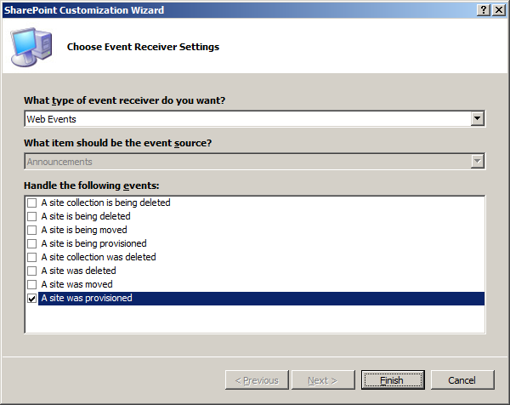
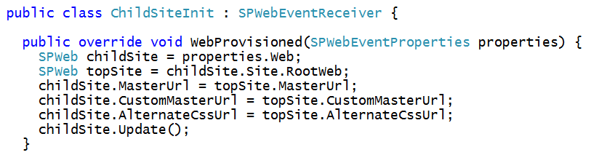
Add Event Receiver for New Child Sites
New sites must be configured as they are created
WebProvisioned event provides trigger to execute code
Child site properties configured with top site properties
Notes:
You have to deal with the scenario when a child site is created within a site collection after your branding feature has been activated. If you don't take any steps, any new site will have the default SharePoint 2010 look and feel.
A simple way to accomplish this is by adding a event receiver which handles the WebProvisioned event. This will allow you to create an event handler which fires any time a new child site is created. You code can simply copy the important property values from another site such as the parent site or the top-level site as shown in the slide above.

Slide 29
DEMO
Creating a Sandbox-Friendly
Branding Solution

Slide 30
Agenda
Understanding Solution Packages and Features
Developing with Visual Studio 2010
Creating a Custom Branding Solution
Creating Solutions to Deploy Page Layouts

Slide 31
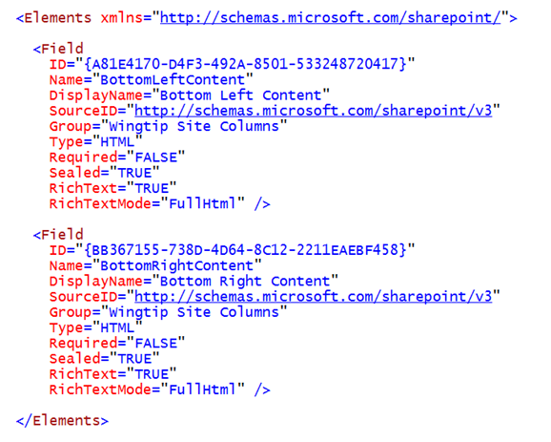
Creating Site Columns in a Feature
Site columns created using Field elements
There is no project item template for site columns
Create a new project item based on Empty Element
Notes:
A site column definition is created using a Field element. Note that the SharePoint Developer Tools do not provide a dedicated SharePoint project item template for creating site column definitions. Therefore, you should create a new project item using SharePoint project item template named Empty Element and add Field elements to the project item’s elements.xml file.
The Field element contains attributes such as ID, Name, DisplayName, Group, and Type. You will need a new globally unique identifier (GUID) each time you create a new site column definition. Note that Visual Studio 2010 provides a handy utility named GuidGen.exe that can be used to create new GUIDs and copy them to the Clipboard.
One other important detail is that you must include the curly braces for GUIDs that are used as the ID in a Field element. Unfortunately, SharePoint Foundation is inconsistent about when it requires curly braces on the GUIDs you have created. Here is a case where each GUID must be added with curly braces for the site column definition to work properly.

Slide 32
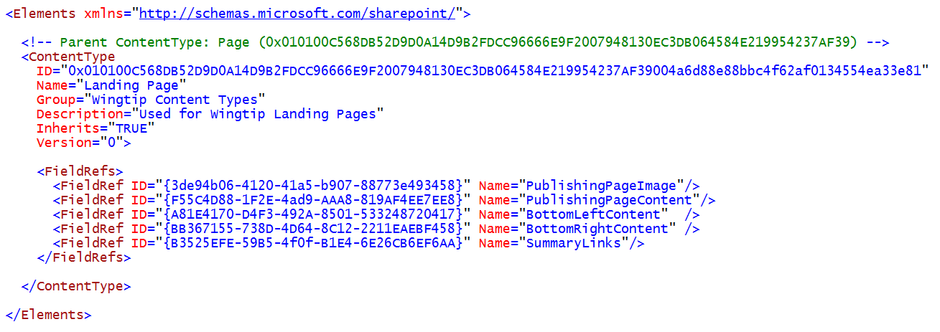
Creating Content Types in a Feature
Content Type created using Site Columns
There is a project item template for content types
Content Type IDs are tricky - let Visual Studio create it
Create new content type inheriting Page content type
Notes:
A content type definition is created using a ContentType element. The ContentType element must contain a set of required attributes and a collection of field links created using FieldRef elements. Each content type definition also requires an ID that begins with the content type ID of its parent. For example, the content type ID for the Announcement content type is 0x0104, which inherits from the Item content type with an ID of 0x01.
Each FieldRef element references a specific site column definition using both the identifying GUID and its string-based name. Before you can create a content type definition, you must decide which base content type to inherit from. For example, you can inherit from a standard list content type such as Item, Contact, or Task. When you are creating a content type for a page layout you must inherit from the Page content type.
When you are creating a content type for a page layout it is important that your test site for the current project is a publishing site. The SharePoint Developer Tools provide a dedicated SharePoint project item template named Content Type. When you create a new Content Type project item, the SharePoint Customization Wizard prompts you to select a base content type from a drop-down list. If you select a base content type of Page, the SharePoint Customization Wizard will generate a new content type definition with an empty FieldRefs element. It will build the Content Type ID for you and then all you need to do it add the required FieldRef elements.

Slide 33
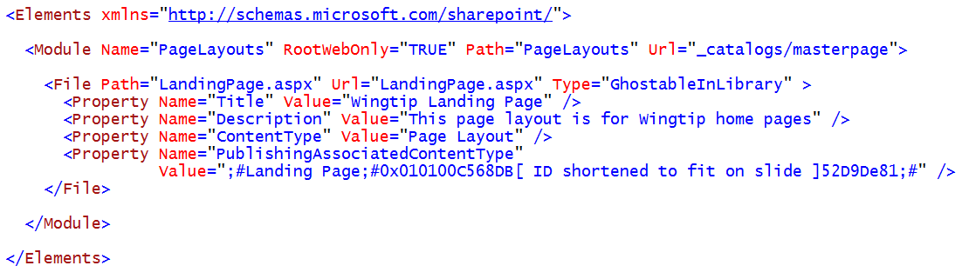
Deploying Page Layouts using Modules
Page Layouts deployed using Module
Requires manual edits to elements.xml
Add four properties shown below in slide
Notes:
You deploy Page Layouts into the Master Page Gallery using a Module. After creating a Module in a SharePoint project and adding the file for your Page Layout, you must then make manual edits to the elements.xml as shown in the slide above.
In particular, you should add four properties to properly configure the Page Layout which are Title, Description, ContentType and PublishingAssociatedContentType. The first two properties are pretty straight ahead. The second two require a brief explanation.
The Content Type property is assigned a value of Page Layout which tells SharePoint that the file being added to the Master Page Gallery should be configured as a Page Layout as opposed to a Master Page.
The PublishingAssociatedContentType is used to configure the associated content type on which the Page Layout is based. This is tricky to work with because you must provide both the Title and the ID of the associated content type in a format that is delimited by a semicolon followed by a pound sign (;#). The format looks like this.
;#[TITLE_GOES_HERE];#[ID_GOES_HERE];#
The make things more confusing, the ID of a content type that inherits from the Page content type is extreme long. However, you can just copy and paste it from the elements.xml file where the content type is defined.

Slide 34
DEMO
Walkthrough of a SharePoint Project which deploys Page Layouts

Slide 35
Agenda
Understanding Solution Packages and Features
Developing with Visual Studio 2010
Creating a Custom Branding Solution
Creating Solutions to Deploy Page Layouts

